Slide 1

What is a STACK ?
A stack is a container of elements that are inserted and removed according to the last-in first-out (LIFO)
principle.
A stack is a ordered list of elements of same data type
A stack is a Linear list

Slide 2
What is a STACK ?
In a stack all
operation like insertion and deletion are performed at only one end called
Top
0 1 2 3 4

Slide 3
What is a STACK ?
Stacks have restrictions on the
insertion and deletion of elements. Elements can be inserted or deleted only from one end of the stack i.e. from
the top.The element at the top is called the top element.The operations of inserting and deleting elements are
called push() and pop() respective
ly.
Insertion
Deletion
4
Top
3
2
1
Insertion and deletion are performed at only one end called Top
0

Slide 4

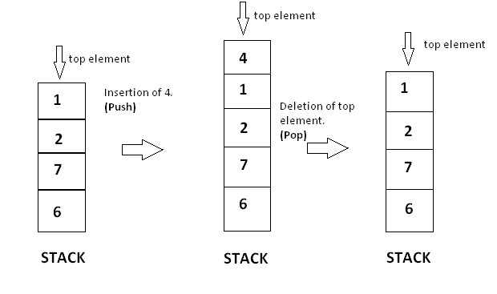
Insertion and Deletion

Slide 5

Insertion or Push Operation
Insertion or push operation requires following steps in general:
If stack is already filled then insertion can not happen
Increase the size of stack and then insert the desired elements

Slide 6

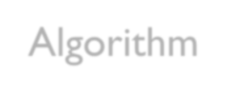
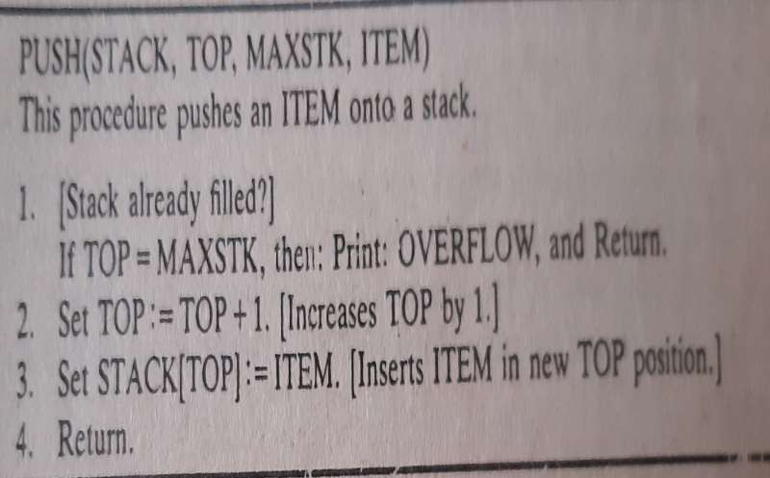
Insertion or Push Operation Algorithm

Slide 7
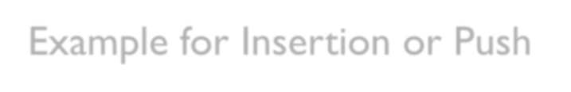
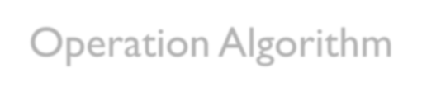
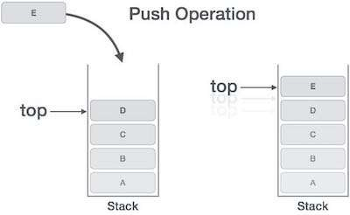
Example for Insertion or Push Operation Algorithm

Slide 8
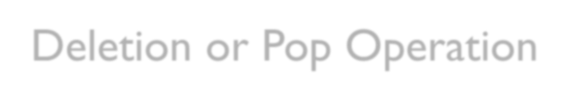
Deletion or Pop Operation
Deletion or pop operation requires following steps:
If the stack has no element then deletion can not happen
Remove the item from top of stack
Decrease the size of stack.

Slide 9

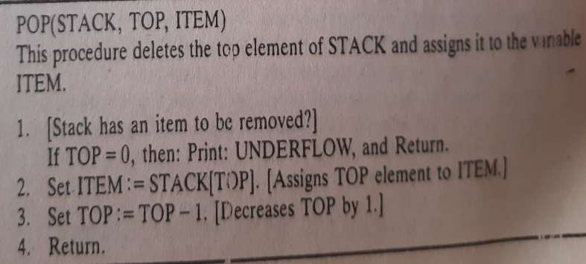
Deletion or Pop Operation Algorithm

Slide 10

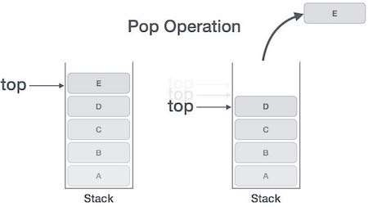
Example for Deletion or Pop Operation Algorithm

Slide 11
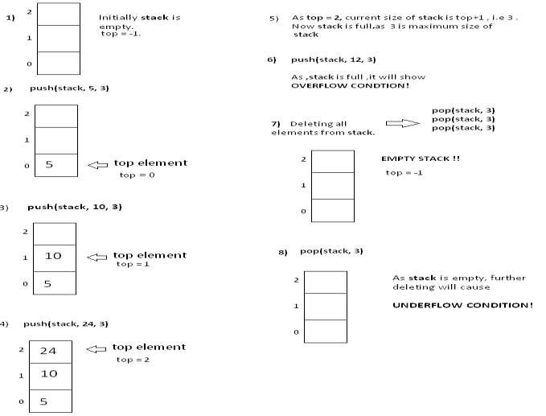
Example for Deletion or Pop Operation Algorithm

Slide 12

Applications of Stack
There are many situations where a stack can be useful, a few implementations of it’s use could be found in:
Backtracking features - This could be an undo feature in a text editing application or to a previous choice point in a game.The stack simply allows us to pop the previous item from it’s data structure.
Recursive algorithms - During recursion, we sometimes need to push temporary data onto a stack, popping the data as we back track through the stages of our algorithm.

Slide 13

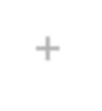
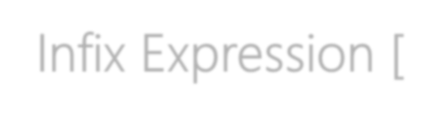

Infix Expression [X + Y]
Operators are written in-between their operands.This is the usual way we write expressions.
An expression such as
A * ( B + C ) / D
is usually taken to mean something like: "First add B and C together, then multiply the result by A, then divide by D to give the final answer."

Slide 14

Postfix Notation [XY+]
Also known as "Reverse Polish notation"
Operators are written after their operands.
The infix expression of A * ( B + C ) / D is equivalent to A B C + * D /
The order of evaluation of operators is always left-to-right, and brackets cannot be used to change this order.
Because the "+" is to the left of the "*" in the example above, the addition must be performed before the multiplication.

Slide 15
Postfix Notation [XY+]
A B C + * D /
Operators act on values immediately to the left of them. For example, the "+" above uses the "B" and "C".We can add (totally unnecessary) brackets to make this explicit: ( (A (B C +) *) D /)
Thus, the "*" uses the two values immediately preceding: "A", and the result of the addition. Similarly, the "/" uses the result of the multiplication and the "D".

Slide 16

Prefix Notation [+XY]
Also known as "Polish notation“
The infix expression of A * ( B + C ) / D is equivalent to / * A + B C D
As for Postfix, operators are evaluated left-to-right and brackets are more than required . Operators act on the two nearest values on the right. I have again added (totally unnecessary) brackets to make this clear:
(/ (* A (+ B C) ) D)

Slide 17

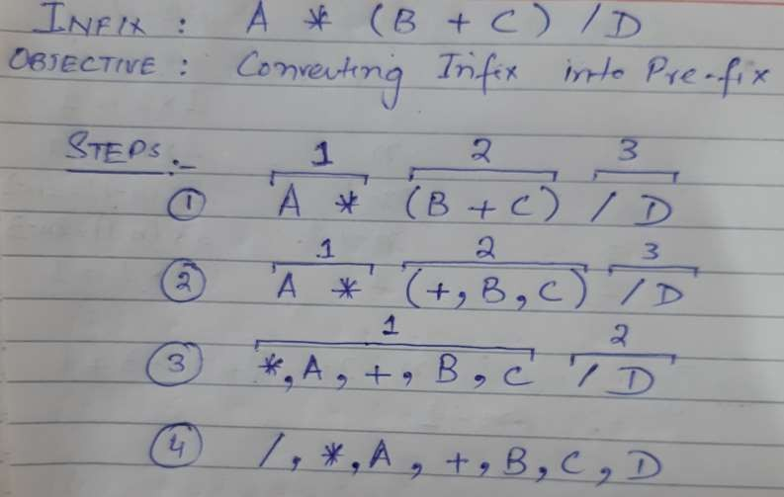
Conversion from Infix to Prefix

Slide 18
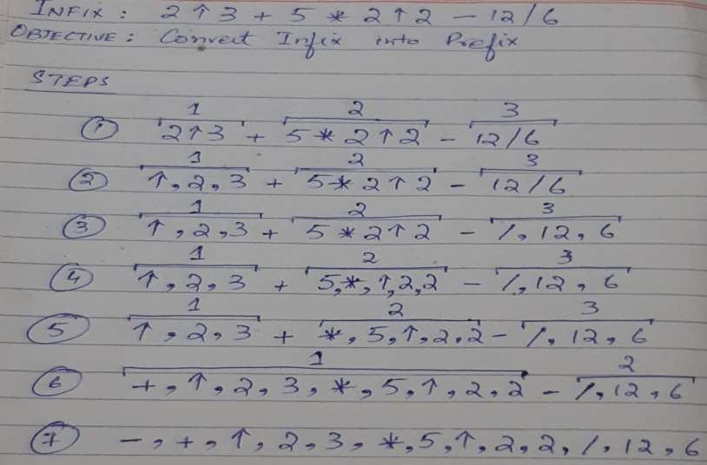
Conversion from Infix to Prefix

Slide 19
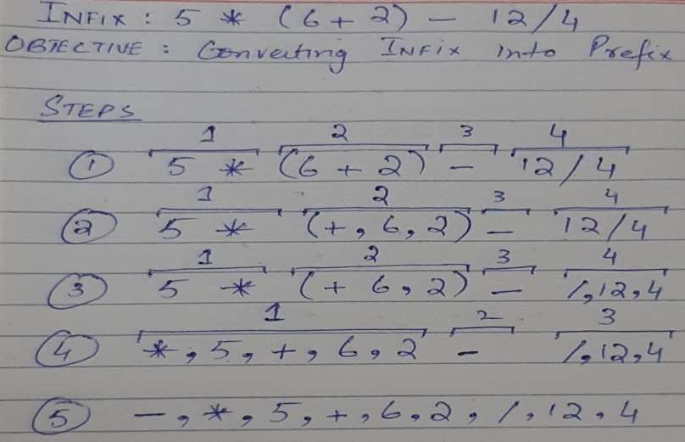
Conversion from Infix to Prefix

Slide 20

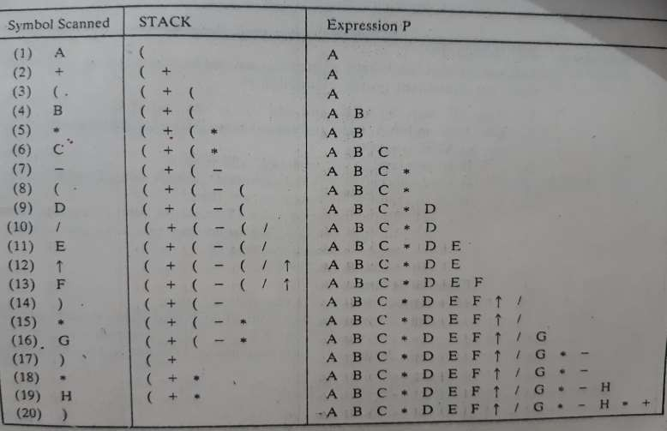
Converting an Infix expression into Postfix via Algorithm

